Slide 1
Agrégation spatiotemporelle pour la visualisation de traces d’exécution
Damien Dosimont
Advisor: Guillaume Huard – Co-advisor: Jean-Marc Vincent

Slide 2


Systems and applications become more and more complex to analyze

Slide 3



Embedded systems
f(x)/s
Not developer
friendly
Quantity of
events over time
Real time
Deep software
stack

Slide 4



Parallel systems
f(x)/s
Resource
sharing
Complex
& Distributed
Artchitecture
Quantity of
events over time
Indeterminism
Middlewares

Slide 5





Trace Analysis
Instrument complex system/application
Collect information about the execution and save them in a file
Process trace data
Statistics
A
Automatic approach
Analyze the content
Visualization

Slide 6

Main thread

Slide 7




TSRecord use case
Streaming
Record
TV program
Set-top box
Hard drive

Slide 8

May the quality of service be with you

Slide 9
How to analyze this application?
?

Slide 10
Analysis based on visualization
Space-time diagram inspired by Gantt Chart

Slide 11
From the perturbation to the source code
Function green(){
…
}
Function red(){
…
}
Function purple(){
…
}

Slide 12

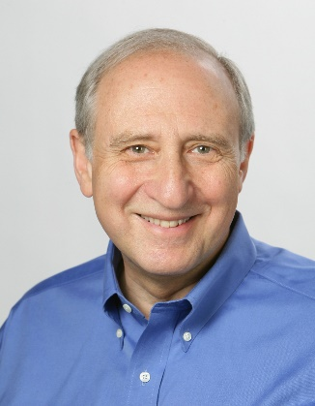




Shneiderman’s mantra
Overview first,
Zoom
and
Filter,
then
Details-on-demand
}

Slide 13
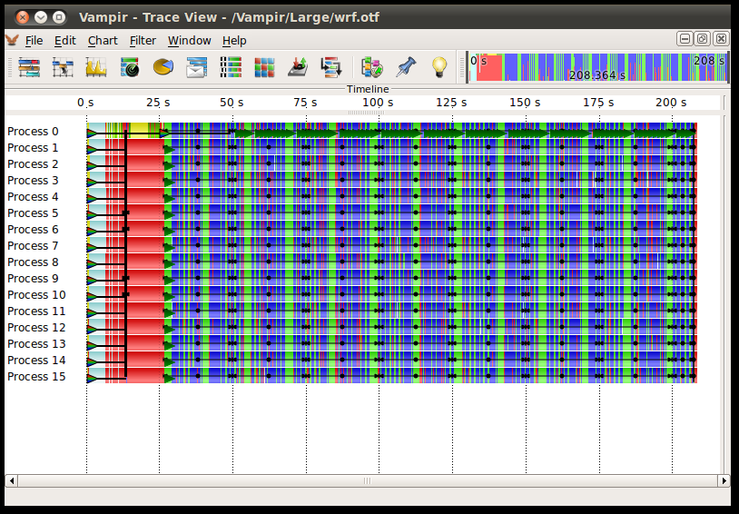
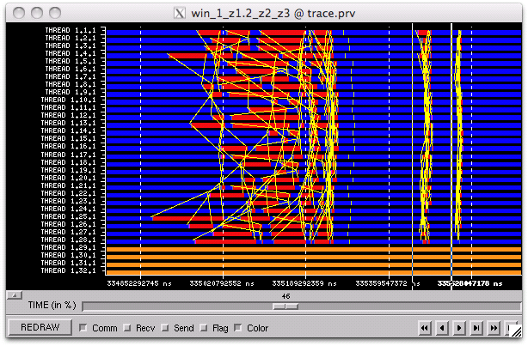
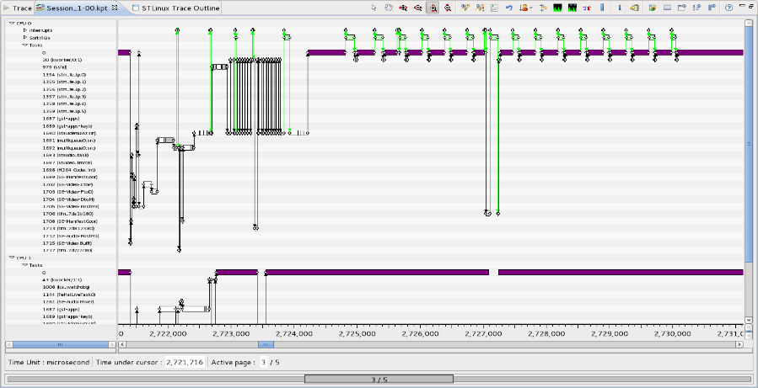
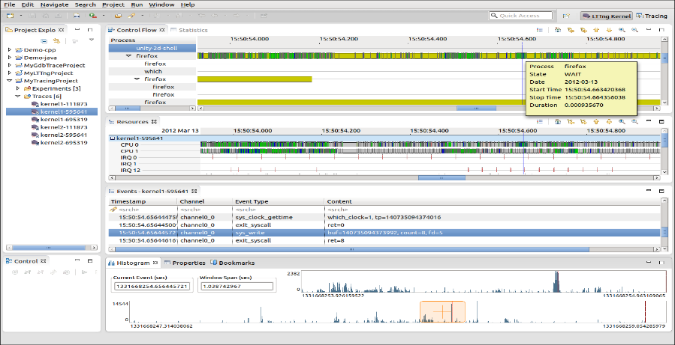
Examples of tools using Gantt chart
Vampir
Paraver
T-Charts (Lite)
Trace Compass

Slide 14





What about scalability?

Slide 15
A few figures…
TS Record use case
82 second duration
258,519 events
12.7 MB
482 second duration
1,642,033 events
83.3 MB
LU class C 700 MPI threads running on G5K (Nancy)
71 second duration
218,457,456 events
12.3 GB

Slide 16

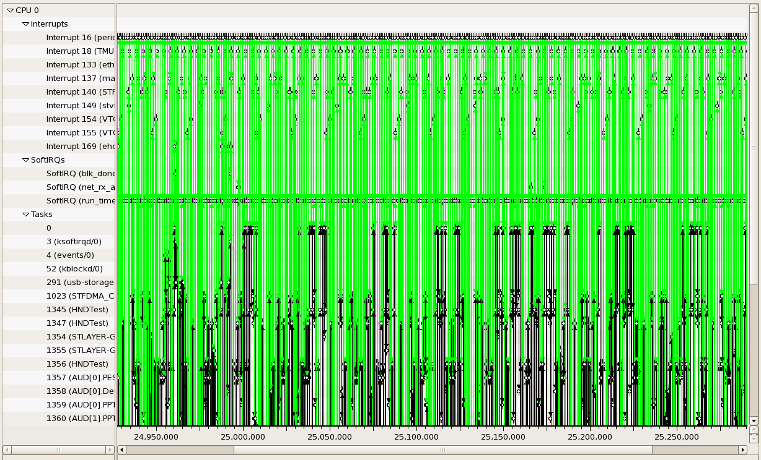
Visualization support

Slide 17
Visualization support
+
=
≈
6 graphical objects
4 available pixels
Fitting graphical
objects with pixels
Final representation:
-some objects are lost
-proportions are not kept

Slide 18
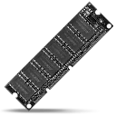


Performance
Memory Limitations
Hardware performance
Algorithmic complexity
Libraries, components, languages, etc.

Slide 19

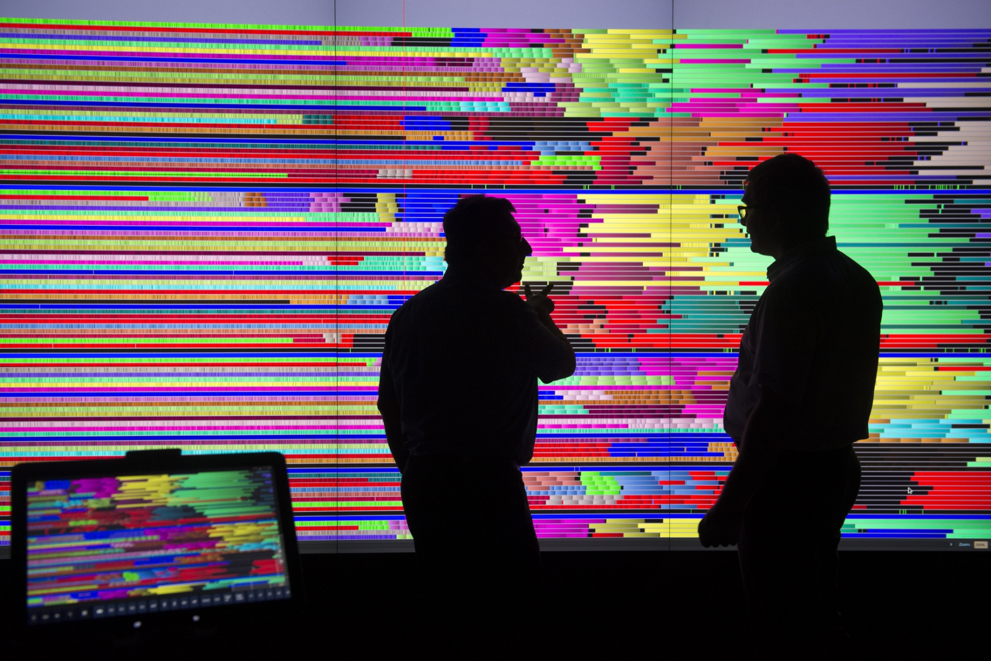
User

Slide 20


Shneiderman’s mantra
Overview first,
Zoom
and
Filter,
then
Details-on-demand
}

Slide 21

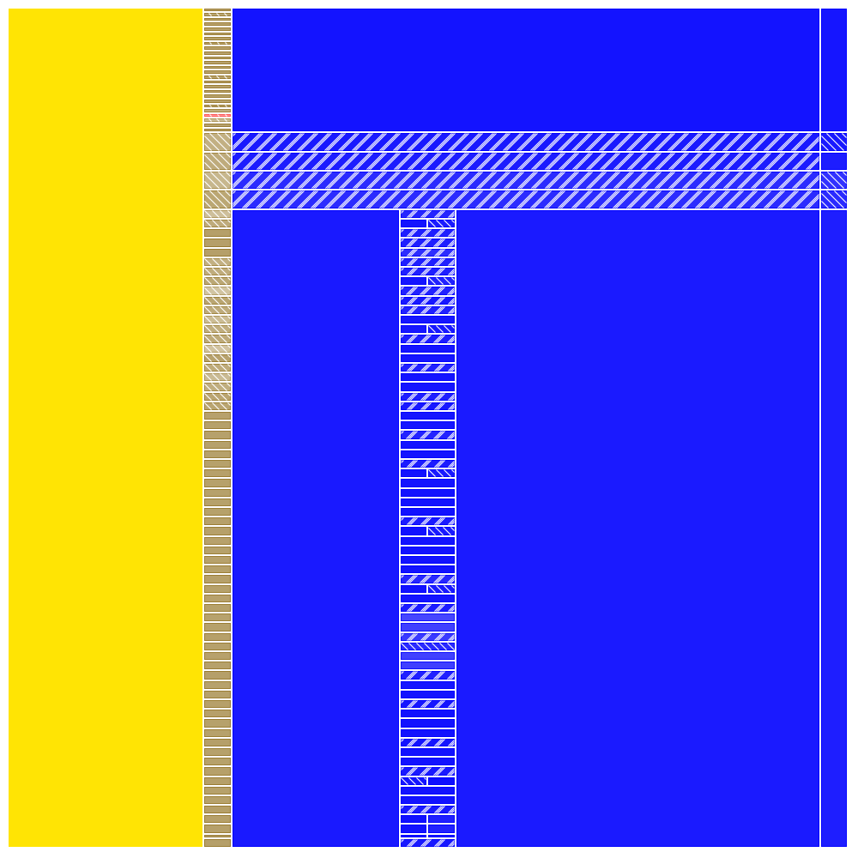
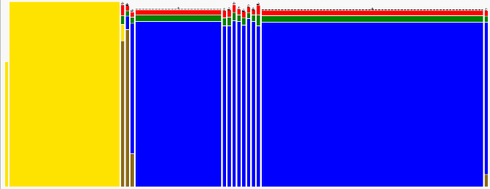


Proposal

Slide 22





Outline
Context
Temporal Overview
Spatiotemporal Overview
Implementation: Ocelotl Analysis Tool
Conclusion

Slide 23

Temporal Overview

Slide 24
Interest of Temporal Analysis

Slide 25




Lamarche-Perrin’s method
Microscopic
Representation
Abstraction
Complex
System
Microscopic
Obervation
Macroscopic
Representation
Method based on Partition+Aggregation
Analyst

Slide 26
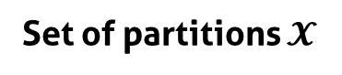

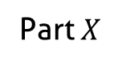
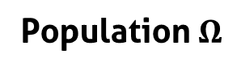
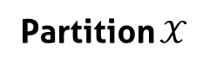
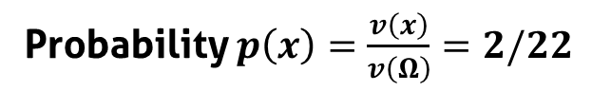
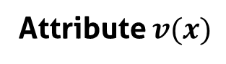
Notations
Part $X$
5
Population $Ω$
1
5
9
1
Individuals $x$
9
1
1
4
2
Attribute $v(x)$
2
4
Probability $p\left(x\right)=\frac{v\left(x\right)}{v\left(Ω\right)}=2/22$
Partition $𝒳$
Set of partitions $𝓧$
5
5
1
5
5
5
1
1
9
1
1
9
9
1
9
9
1
1
1
1
2
2
2
2
4
…
4
4
4
4
2

Slide 27
From the partition to the interpretation
5
15
5
5
1
9
5
5
1
9
1
1
1
1
4
2
4
2
6
3
3
Aggregation
(sum)
Redistribution
(uniform)
Population
Partition
Visualization

Slide 28
How to choose the « good » partitions?
?
5
5
1
5
5
5
1
1
9
1
1
9
9
1
9
9
1
1
1
1
4
2
4
2
4
2
4
2
4
2
Best Partition Problem

Slide 29
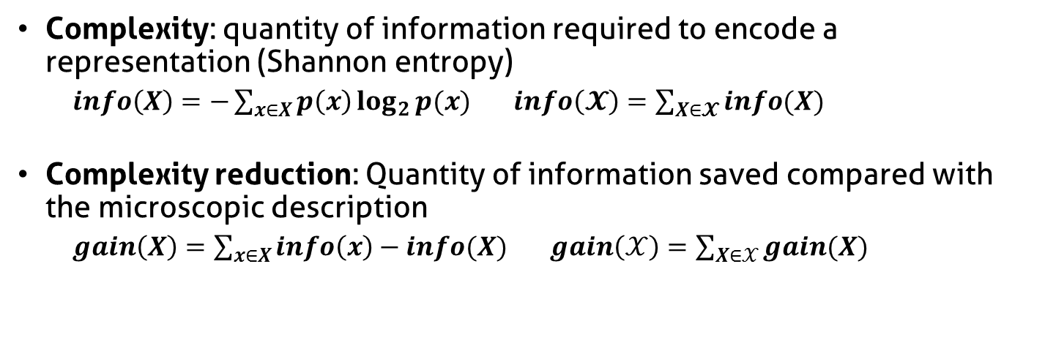
Complexity reduction
Complexity: quantity of information required to encode a representation (Shannon entropy)
$info\left(X\right)=−\sum_{x∈X}{p\left(x\right)\log_{2}{p(x)}}$ $info\left(𝓧\right)=\sum_{X∈𝓧}{info(X)}$
Complexity reduction: Quantity of information saved compared with the microscopic description
$gain\left(X\right)=\sum_{x∈X}{info\left(x\right)−info(X)}$ $gain\left(𝒳\right)=\sum_{X∈𝒳}{gain(X)}$
Complexity reduction
5
5
5
1
1
1
1
1
1
9
9
9
2
2
2
4
4
4
Number of elements (aggregates)

Slide 30
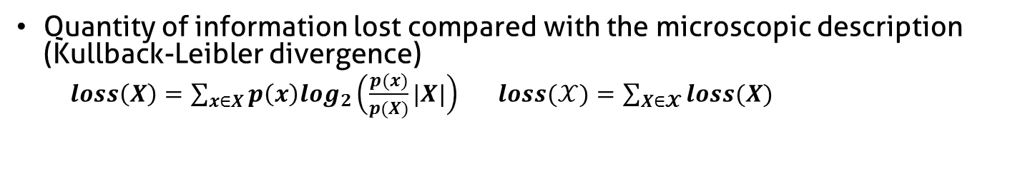
Information Loss
Quantity of information lost compared with the microscopic description (Kullback-Leibler divergence)
$loss\left(X\right)=\sum_{x∈X}{p\left(x\right)log_{2}\left(\frac{p(x)}{p(X)}|X|\right)}$ $loss(𝒳)=\sum_{X∈𝓧}{loss(X)}$
5
High
Information Loss
4
1
1
4
4
9
4
4
4
4
4
5
Low
Information Loss
4
4
4
4
4
4
4
4
4
3
4

Slide 31
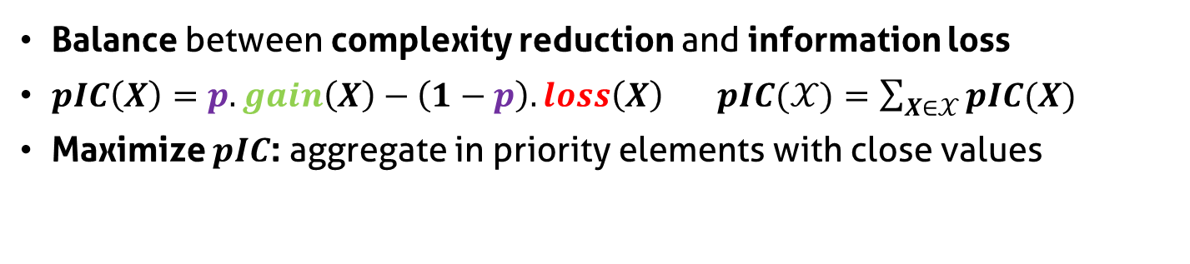
Parametrized Information Criterion
Balance between complexity reduction and information loss
$pIC\left(X\right)=p.gain\left(X\right)−\left(1−p\right).loss\left(X\right)$ $pIC(𝒳)=\sum_{X∈𝒳}{pIC(X)}$
Maximize $pIC$: aggregate in priority elements with close values
Parameter p
Complexity reduction
5
5
5
1
1
1
1
1
1
9
9
9
2
2
2
4
4
4
Information loss

Slide 32


Constrain the partition
Reduce the set of partition size
Decrease algorithmic complexity
Bring coherence with syntaxic and semantic characteristics of the system

Slide 33

How to adapt LP method to trace analysis ?
?
?
?
Microscopic
Representation
?
Abstraction
Complex
System
Microscopic
Observation
?
Macroscopic
Representation
Analyst

Slide 34

How to generate the microscopic model ?
Microscopic
Representation
Abstraction
Trace
Microscopic
Observation
Macroscopic
Representation
Analyst

Slide 35
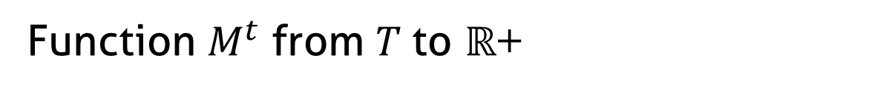
Original microscopic model
Function $M^{t}$ from $T$to $ℝ$+
t1
t2
t3
t4
t5
Time (discrete)

Slide 36
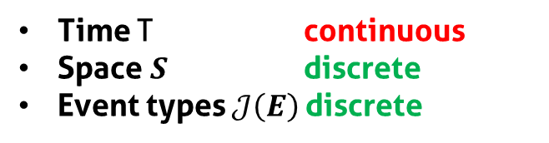
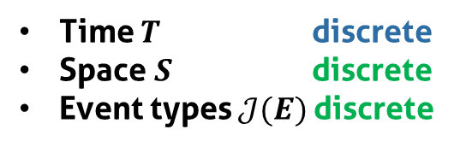
Build a microscopic model from the trace
Trace =
Nanoscopic
Model
Discretization
Microscopic
Model
Time T continuous
Space $S$ discrete
Event types $𝒥\left(E\right)$discrete
Time $T$ discrete
Space $S$ discrete
Event types $𝒥(E)$discrete

Slide 37
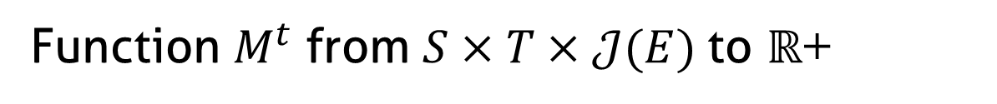
Microscopic model structure
Function $M^{t}$ from $S×T×𝒥(E)$to $ℝ$+
J5
J4
J3
Event types
J2
J1
s1
Space
s2
s3
t1
t2
t3
t4
t5
Time (discrete)

Slide 38
Fill the microscopic model
Time (continuous)
Sum of state durations
s1
s2
Space
s3
Time slice
J5
J4
Event types
J3
J2
J1
d1 + d2 + p1*d3
s1
s2
Space
d1+d2+p1*d3
s3
t1
t2
t3
t4
t5
Time (discrete)

Slide 39
How to aggregate the microscopic model ?
Microscopic
Representation
Abstraction
Trace
Microscopic
Obervation
Macroscopic
Representation
Analyst

Slide 40
How to aggregate the microscopic model
Original algorithm:
scalar values
t1
t2
t3
t4
t5
Time (discrete)
Objective:
multidimensional
values
t1
t2
t3
t4
t5
Time (discrete)

Slide 41



Aggregation process
Microscopic
Representation
Abstraction
Trace
Microscopic
Obervation
Macroscopic
Representation
Quality
Measures
Best Cut
Computation
Partition
Computation
Visualization
Technique
Analyst
p

Slide 42
Visualization
Microscopic
Representation
Abstraction
Trace
Microscopic
Obervation
Macroscopic
Representation
Quality
Measures
Best Cut
Computation
Partition
Computation
Visualization
Technique
Analyst

Slide 43
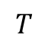
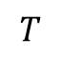
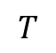
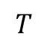
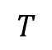
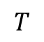
Visualize the trace abstraction
Bar chart
$$T$$
Colored
partition
$$T$$
$$T$$
Stacked bar
chart
$$T$$
$$T$$
Mode
$$T$$
Spatial aggregation
Aggregation of event types

Slide 44
Stacked bar chart visual aggregation
minimal height
blue + orange event type
total height < minimal height
blue event type
height < minimal height
blue + orange event type
individual height < minimal height
total height > minimal height
Decrease available height

Slide 45
Example of analyses

Slide 46

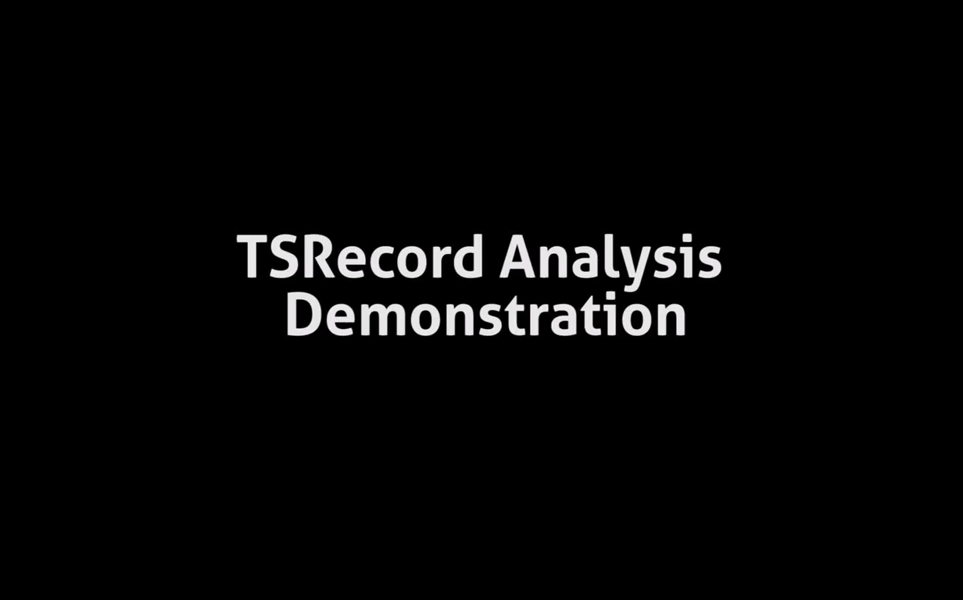

Slide 47

LU class C (700 processes) on G5K
MPI_Allreduce
MPI_Wait
MPI_Send
700
Activity Ratio
0
0 s
74 s
Time
MPI_Recv
MPI_init

Slide 48

We need some space!

Slide 49

Spatiotemporal Analysis
+

Slide 50




Influence of the hierarchy
Hardware components
Site
Clusters
Nodes
Cores
Threads
Software components

Slide 51
How to generate a spatiotemporal representation following LP method ?
?
?
?
Microscopic
Representation
?
Abstraction
Complex
System
Microscopic
Observation
?
Macroscopic
Representation
Analyst

Slide 52
How to generate the microscopic model ?
Microscopic
Representation
Abstraction
Trace
Microscopic
Observation
Macroscopic
Representation
Analyst

Slide 53
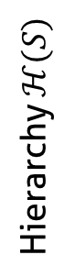
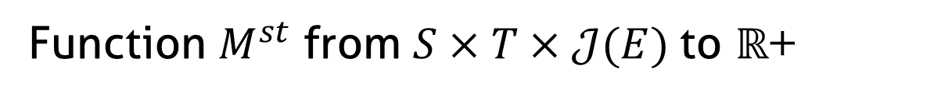
Hierarchize the spatial dimension
Function $M^{st}$ from $S×T×𝒥(E)$to $ℝ$+
Event types
J3
J2
J1
s1
Sa
s2
Hierarchy $ℋ(S)$
s3
S
s4
Sb
s5
t1
t2
t3
t4
t5
Time (discrete)

Slide 54
How to aggregate this microscopic model ?
Microscopic
Representation
Abstraction
Trace
Microscopic
Obervation
Macroscopic
Representation
Analyst

Slide 55
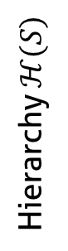
Aggregate the microscopic model
s1
Sa
s2
Hierarchy $ℋ(S)$
s3
S
s4
Sb
s5
t1
t2
t3
t4
t5
Time (discrete)

Slide 56
Forbidden Aggregates
s1
Sa
s2
Hierarchy $ℋ(S)$
s3
S
s4
Sb
s5
t1
t2
t3
t4
t5
Time (discrete)

Slide 57
Best Cut Computation
Microscopic
Representation
Abstraction
Trace
Microscopic
Obervation
Macroscopic
Representation
Quality
Measures
Best Cut
Computation
Partition
Computation
Visualization
Technique
Analyst
p

Slide 58
Best Cut Algorithm: naive approach
Spatial or
Temporal
Cut
Recursion
Spatial or
Temporal
Cut
Recursion
Spatial or
Temporal
Cut

Slide 59

Best Cut Algorithm: dynamic programming
Save the intermediate results
Avoid redundant evaluation
Spatial or
Temporal
Cut
Unavoidable redundancy
Recursion
Spatial or
Temporal
Cut
Recursion
Spatial or
Temporal
Cut

Slide 60
Visualization
Microscopic
Representation
Abstraction
Trace
Microscopic
Obervation
Macroscopic
Representation
Quality
Measures
Best Cut
Computation
Partition
Computation
Visualization
Technique
Analyst

Slide 61
Visualize the abstraction

Slide 62
Visual aggregation
Decrease available height

Slide 63
Example of analyses

Slide 64
LU class C (700 processes) on G5K
MPI_Allreduce
MPI_Wait
MPI_Send
700
Activity Ratio
0
0 s
74 s
Time
MPI_Recv
MPI_init

Slide 65
LU class C (700 processes) on G5K
graphene
graphite
Nancy
griffon
MPI_Allreduce
MPI_Recv
MPI_init
0 s
Time
74 s

Slide 66

Implementation: Ocelotl Analysis Tool

Slide 67
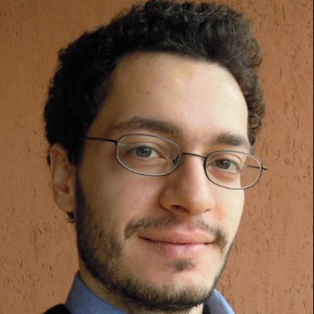

Framesoc

Slide 68


Ocelotl

Slide 69
And Shneiderman’s mantra ?

Slide 70
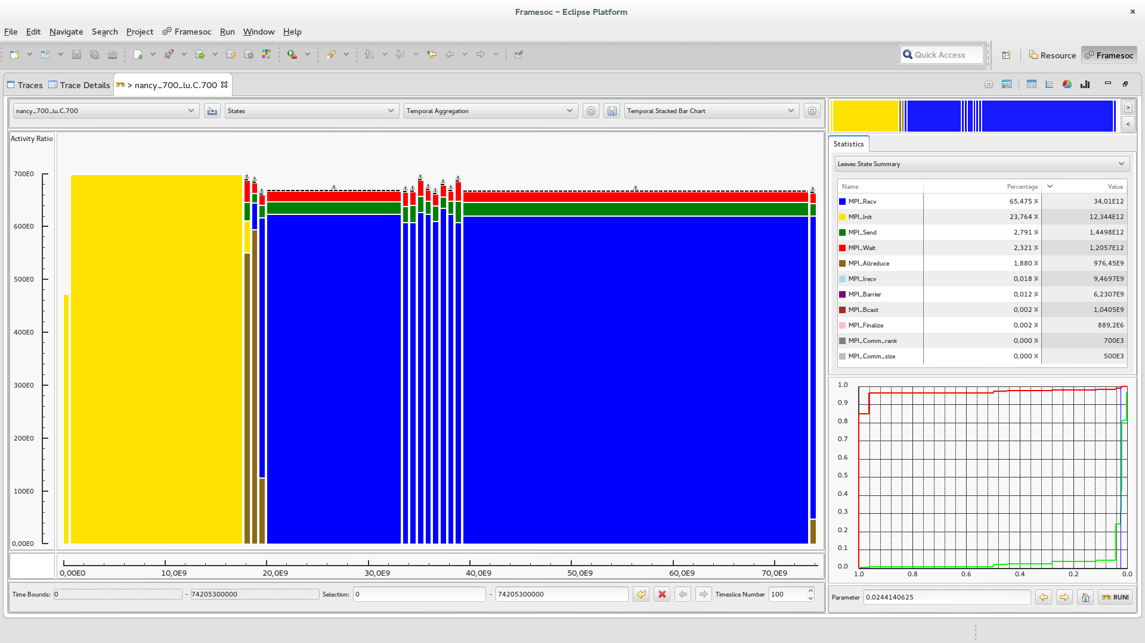
Shneiderman’s mantra: Overview

Slide 71
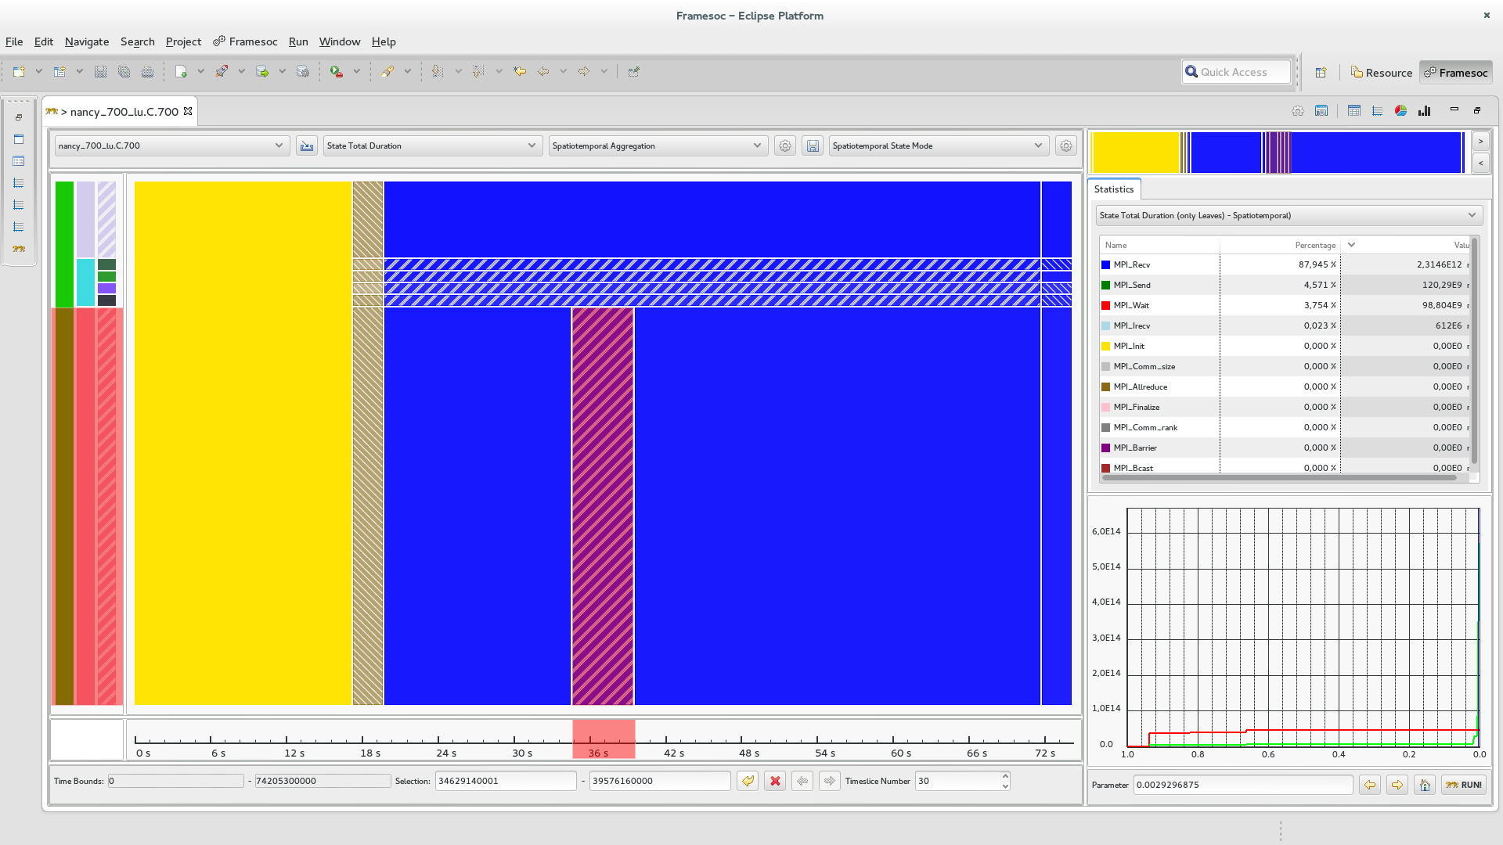
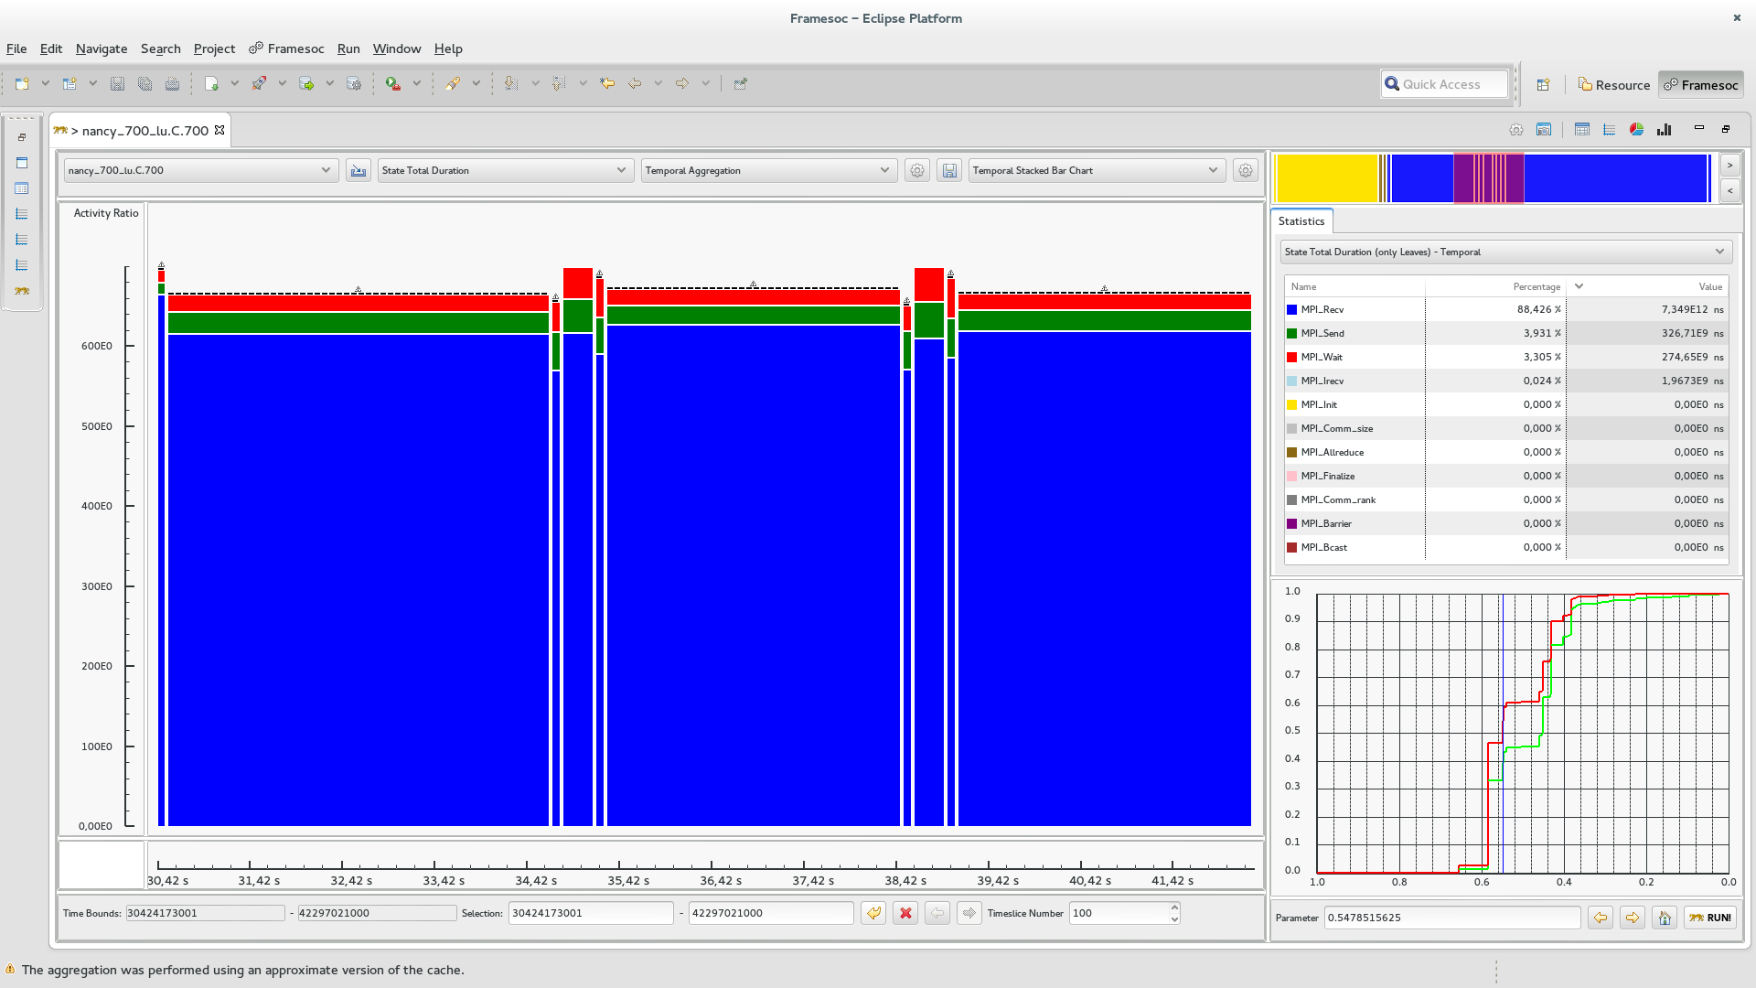
Shneiderman’s mantra: Zoom

Slide 72
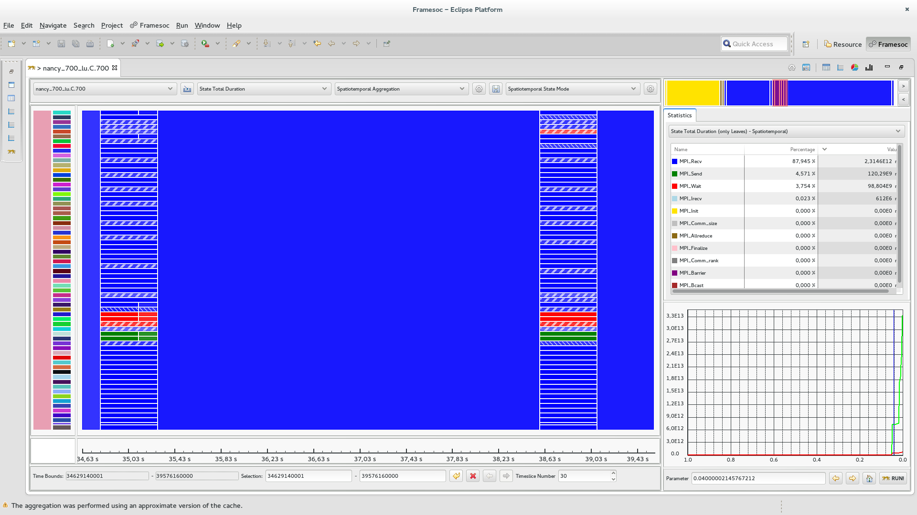
Shneiderman’s mantra: Zoom

Slide 73
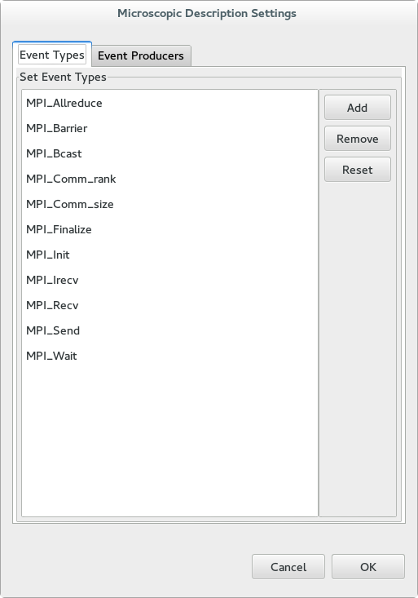
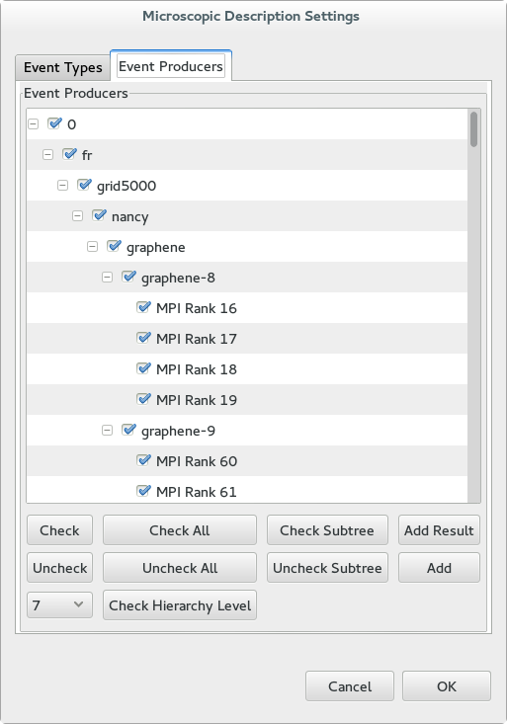
Shneiderman’s mantra: Filter
Event type filtering
Resource filtering

Slide 74
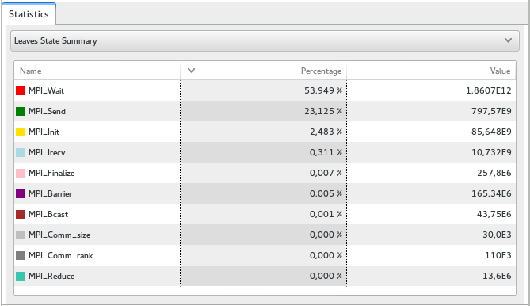
Shneiderman’s mantra: Details on demand

Slide 75
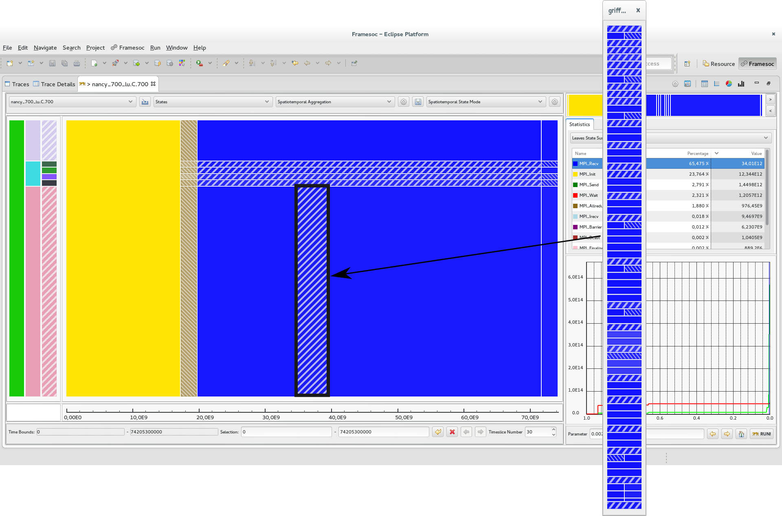
Shneiderman’s mantra: Details on demand

Slide 76
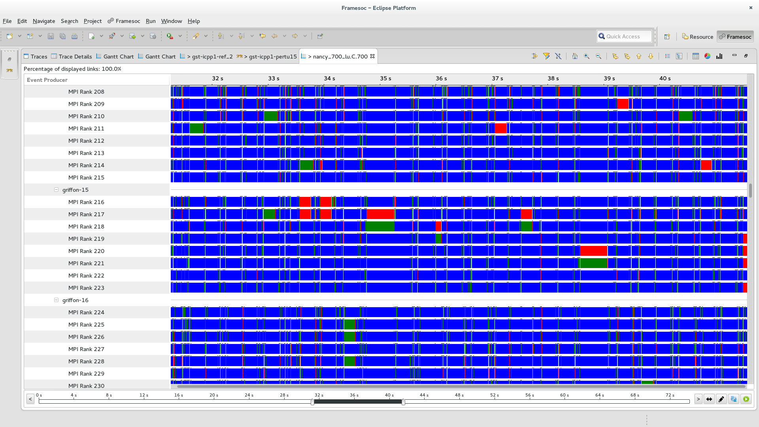
Shneiderman’s mantra: Details on demand

Slide 77

How to improve performance?

Slide 78


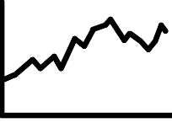
Analysis Pipeline
Quality
Measures
Microscopic
Osbervation
Microscopic
Representation
Quality
Curves
Trace DB
Best Cut
Computation
Partition
Computation
Analyst
Macroscopic
Representation
Visualization
Technique

Slide 79
Avoid useless recomputation during interaction
Quality
Measures
Microscopic
Osbervation
Microscopic
Representation
Quality
Curves
Trace DB
Zoom, filter
Best Cut
Computation
Change aggregation
Partition
Computation
Analyst
Macroscopic
Representation
Visualization
Technique

Slide 80

Improving trace reading
Query
Optimization
Microscopic Model
Cache
Quality
Measures
Microscopic
Osbervation
Microscopic
Representation
Quality
Curves
Trace DB
Best Cut
Computation
Partition
Computation
Analyst
Macroscopic
Representation
Visualization
Technique

Slide 81

Microscopic model persistent cache
First Time:
Trace DB
Microscopic
Osbervation
Fine Time Slice
Granularity
Microscopic Model
Persistent
Cache
Microscopic
Model
Time slice numbers
are multiple
Perfect
Microscopic Model
Other Times:
Approximate
Microscopic Model
Persistent
Cache
Time slice numbers
are not multiple

Slide 82
Microscopic Model Persistant Cache
Cache Size << Trace Size
Reading time only depends on microscopic model size and not on original trace file size

Slide 83
In practice…
Real traces:
Up to 12 GB (218 millions of events)
Temporal: ~1500 resources
Spatiotemporal: ~700 resources
Without cache: ~5 minute preprocess
With cache: ~20 second preprocess
Synthetic traces:
Up to 68 GB (2 billions of events)
Temporal: ~ 100 000 resources, 10 event types, 100 time slices
Spatiotemporal: ~10 000 resources, 10 event types, 30 time slices
Without cache: ~20 minute preprocess
With cache: a few minute preprocess

Slide 84
Conclusion

Slide 85


Overviews
Data aggregation following Lamarche-Perrin’s method
Temporal aggregation: significant extension to trace analysis
Spatiotemporal aggregation: new algorithm
Visualization techniques
Punctual visual aggregation
Shneiderman’s mantra first step

Slide 86
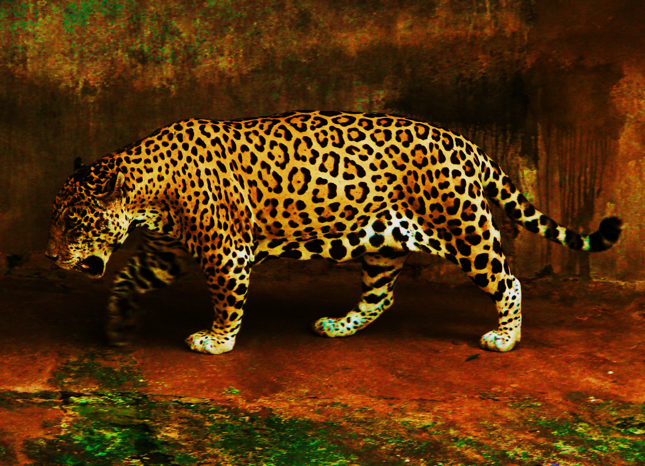






Ocelotl Analysis Tool

Slide 87
Publications
International Conferences
A Spatiotemporal Data Aggregation Technique for Performance Analysis of Large-scale Execution Traces. Damien Dosimont, Robin Lamarche-Perrin, Lucas Mello Schorr, Guillaume Huard, Jean-Marc Vincent, IEEE Cluster 2014, pages 149-157, Madrid, September 2014.
Efficient Analysis Methodology For Huge Application Traces. Damien Dosimont, Generoso Pagano, Guillaume Huard, Vania Marangozova-Martin, Jean-Marc Vincent, 2014 International Conference on High Performance Computing & Simulation, pages 951-958, Bologna, June 2014.
Trace Management and Analysis for Embedded Systems. Generoso Pagano, Damien Dosimont, Guillaume Huard, Vania Marangozova-Martin, Jean-Marc Vincent, 2013 IEEE 7th International Symposium on Embedded Multicore Socs (MCSoC), pages 119-122, Tokyo, September 2013.
Workshops
Ocelotl: Large Trace Overviews Based on Multidimensional Data Aggregation. Damien Dosimont, Youenn Corre, Lucas Mello Schnorr, Guillaume Huard, Jean-Marc Vincent, 8th International Parallel Tools Workshop (IPTW’14), Stuttgart, October 2014.
Agrégation temporelle pour l’analyse de traces volumineuses. Damien Dosimont, Guillaume Huard, Jean-Marc Vincent, 10ème Atelier en Evaluation de Performances, Sophia Antipolis, June 2014.
La visualisation de traces, support à l’analyse, déverminage et optimisation d’applications de calcul haute performance. Damien Dosimont, Guillaume Huard, Jean-Marc Vincent, Atelier Visualisation d’informations, interaction et fouille de données (VIF) de la 13e Conférence Francophone sur l’Extraction et la Gestion des Connaissances (EGC’2013), pages 55-66, Toulouse, January 2013.

Slide 88

Perspectives?

Slide 89
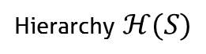
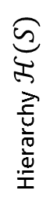
New aggregations
5
4
Discrete Dimension
Hierarchy $ℋ(S)$
3
S
2
1
1
2
3
4
5
Hierarchy $ℋ(S)$
Discrete Dimension
S

Slide 90
Improving the performance
Parallelization
Trace reading
Algorithm
Data structures
Dynamic control
More caches
Prefetching, anticipation

Slide 91

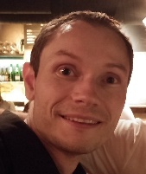









New applications
Abstract traces
Memory analysis
Consumption analysis
Other domains:

Slide 92

Thank you for your attention!

Slide 93
Backup

Slide 94

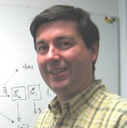


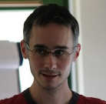

Thanks

Slide 95
Main thread: a recording application
Streaming
Record
TV program
Set-top box
Hard drive
TS Record use case

Slide 96





Quality computation
Intermediate measures
Quality measures
$$Sum\left(S_{a},T_{\left(i,j\right)},J\right)=\sum_{s∈S_{a}}{\sum_{{t∈T}_{(i,j)}}{μ(s,t,J)}}$$
$$Gain(S_{a},T_{\left(i,j\right)},J)$$
$$Info({S_{a},T}_{\left(i,j\right)},J)$$
$$Loss(S_{a},T_{\left(i,j\right)},J)$$
$$Quality\left(S_{a},T_{\left(i,j\right)}\right)=\sum_{J∈𝒥(E)}{Quality(S_{a},T_{\left(i,j\right)},J)}$$
s1
=
+
S
s2
=
+
=
+

Slide 97


Elmqvist & Fekete’s criteria
Entity Budget
Visual Summary
Visual Simplicity
Discriminability
Fidelity
Interpretability

Slide 98


How to build a polynomial algorithm?
Dynamic programming (divide and conquer)
Covering relation (lattice)
Quality measure additivity

Slide 99
Visualize structure and temporal behavior
Space-time diagram inspired by Gantt Chart
Exemple of a sequential pattern with context switches
Exemple of a parallel execution with communications

Slide 100



Best Partition problem
Find the partitions that maximize (minimize) quality measures
Quality measures are monotone, decomposable, and may be additive
$$X_{A}$$
$$Quality(𝒳) = Quality(X_{A}) + Quality(X_{B}) + Quality(X_{C})$$
5
1
9
1
$$X_{B}$$
2
4
$$X_{C}$$

Slide 101

Fill the microscopic model
Event occurrences
Average state duration
Variable mean
Time slice
Time slice
Time slice
1 + 1 + 1
d1 + d2 + p1*d3
a
b
3
(d1+d2+p1*d3)/3
$$\frac{1}{b−a}\int_{a}^{b}{f\left(t\right)dt}$$

Slide 102

Lattice
Partial order

Slide 103

Complexity
Quantity of information required to encode a representation (theoretical)
Uncertainty about the elements of a description whose we only know the probability to appear of the different symbols that are associated with
$info\left(X\right)=−\sum_{x∈X}{p\left(x\right)\log_{2}{p(x)}}$ $info\left(𝓧\right)=\sum_{X∈𝓧}{info(X)}$
Complexity
5
5
5
1
1
1
1
1
1
9
9
9
2
2
2
4
4
4
Number of elements (aggregates)

Slide 104



In a few words…
Analysis of large execution traces, provided by
multimedia/embedded applications
parallel/scientific computing applications
Design of a method based on
visualization
data aggregation
interaction
following a top down approach
Design and implementation in an analysis software

Slide 105

Ex: Hierarchical aggregation
Spatial analysis
Admissible partitions

Slide 106

Ex: Ordered set aggregation
Temporal analysis
Admissible partitions

Slide 107







Information contained in traces
Spatial dimension ($S$)
Hardware resources
Software components
Temporal dimension (T)
Events ($E$)
Categories ($𝒞(E)$):
Types ($𝒥(E)$)

Slide 108




Quality computation of monodimensional values
Monodimensional microscopic model
Intermediate measures
$$Sum(T_{(i,j)})=\sum_{{t∈T}_{(i,j)}}{μ(t)}$$
Time (discrete)
Data structure of time intervals T(i,j)
$$Info(T_{\left(i,j\right)})$$
Quality measures
i
$$Gain(T_{\left(i,j\right)})$$
$$Loss(T_{\left(i,j\right)})$$
j

Slide 109





Quality computation of multidimensional values
Intermediate measures
$$Sum(s,T_{\left(i,j\right)},J)=\sum_{{t∈T}_{(i,j)}}{μ(s,t,J)}$$
Jr
Jb
s1
$$Info({s,T}_{\left(i,j\right)},J)$$
Quality measures
s2
$$Gain(s,T_{\left(i,j\right)},J)$$
$$Loss(s,T_{\left(i,j\right)},J)$$
=
+
+
+
$$Quality(T_{(i,j)})=\sum_{s∈S}{\sum_{J∈𝒥(E)}{Quality(s,T_{\left(i,j\right)},J)}}$$

Slide 110


Best cut computation
Compute, compare, and select pIC for time intervals
pIC=p*gain-(1-p)*loss
User provides p
Already
computed
Ex: 4 time slices
$$pIC=pIC(T_{3})+pIC(T_{4})$$
Possible cuts: Cut[i]
i=4
Cut[4]=4
$$pIC=pIC(T_{(3,4)})$$
i=3
or
Cut[3]=3 or 4
i=2
or
or
Cut[2]=2, 3 or 4
or
or
i=1
Cut[1]=1, 2, 3 or 4
or

Slide 111

Rebuild the best partition
Example
Cut[1]?
Cut[1]=2
Cut[2+1]?
Cut[3]=3
Cut[3+1]?
Cut[4]=4
Best Partition

Slide 112
Aggregate and redistribute the values
Microscopic model
Partition
?
Aggregation (sum)
!
Uniform redistribution

Slide 113

Build a microscopic model from the trace
Trace =
Nanoscopic
Model
Discretization
+ Hierarchization
Microscopic
Model
Time continuous
Space flat
Event types discrete
Time discrete
Space hierarchized
Event types discrete

Slide 114




Performance
! Query optimization
Microscopic
model
Qualities
Quality curves
Abstraction
Trace (DB)
Visualization
! Microscopic Model
Cache

Slide 115


Main thread
Parameter p increasing
$$T$$
$$T$$

Slide 116



CG class C (64 processes) on G5K
64
Rennes
Activity Ratio
0
64
Nancy
Activity Ratio
0
64
Grenoble
Activity Ratio
0
0 s
26 s
54 s
125 s
Time

Slide 117


Knowledge on the application
IP buffers
Memory
Hard drive
IP packets
sys_write()
flush-8:0
every
100 ms
Disk cache
every
5000 ms
230 KB

Slide 118
Multi agent system analysis
Analytic approach
Complex
System
Microscopic
Obervation
Microscopic
Representation
Analyst
Complexity
Quantity of data

Slide 119
Multi agent system analysis
Systemic approach
Microscopic
Representation
Abstraction
Complex
System
Microscopic
Obervation
Macroscopic
Representation
Analyst

Slide 120
Microscopic model structure
Function $M^{st}$ from $S×T×𝒥(E)$to $ℝ$+
Event types
J3
J2
J1
s1
s2
Space
s3
s4
s5
t1
t2
t3
t4
t5
Time (discrete)

Slide 121
How we imagine analyzing the application

Slide 122
Best Cut Algorithm : naive approach
Decomposition
Recursion
Decomposition
Recursion
Decomposition

Slide 123
Best Cut Algorithm : dynamic programming
Decomposition
Recursion
Save the intermediate results
Decomposition
Recursion
Decomposition
Avoid redundant evaluation

Slide 124
Solving the problem
IP buffers
Memory
Hard drive
IP packets
sys_write()
flush-8:0
every
100 ms
Disk cache
every
5000 ms
230 KB
quantity of data
During the flush, the cache is locked
Writing on the USB disk is slow, IP buffers are overflowed
Linux configuration: flush should depend on quantity of data and not on time

Slide 125

Context

Slide 126
Trace content
Microscopic
Representation
Abstraction
Trace
Microscopic
Observation
Macroscopic
Representation
Analyst

Slide 127
Trace content
Spatial dimension ($S$)
Hardware resources
Software components
Temporal dimension (T)
Events ($E$)
Categories ($𝒞(E)$):
Types ($𝒥(E)$)

Slide 128
Lamarche-Perrin’s Method

Slide 129
Query Optimization
Not optimized query: time interval + space elements + event types
Full overview: evaluate time, space and types is useless
Zoom or filter over less than 3 dimensions: queries can also be simplified
Advanced simplifications
Constant factor gain improves interactivity

Slide 130



Temporal Aggregation
$$𝒪({\left|T\right|}^{2}×\left|S\right|×\left|𝒥\left(E\right)\right|)$$
$$𝒪(\log_{2}\left(seuil\right)×{\left|𝓘\left(T\right)\right|×\left|T\right|}^{2})$$
$$𝒪({\left|T\right|}^{2})$$
Fixed values: $\left|S\right|=1000, \left|𝒥\left(E\right)\right|=10, threshold=0.001$

Slide 131



Spatiotemporal Aggregation
$$𝒪({\left|T\right|}^{2}×\left|ℋ(S)\right|×\left|𝒥\left(E\right)\right|)$$
$𝒪(\log_{2}\left(seuil\right)×{\left|𝓐\left(S×T\right)\right|×\left|T\right|}^{3}×|ℋ(S)|$)
$$𝒪({\left|T\right|}^{3}×|ℋ(S)|)$$
Fixed values: $\left|𝒥\left(E\right)\right|=10, threshold=0.001$

Slide 132

LU class C (700 processes) on G5K
Nancy
(no cluster/machine
level)
MPI_Allreduce
MPI_Recv
MPI_init
0 s
Time
74 s

Slide 133

Shneiderman’s mantra: Zoom

Slide 134

Shneiderman’s mantra: Zoom

Slide 135

Shneiderman’s mantra: Zoom

Slide 136
Shneiderman’s mantra: Zoom

Slide 137
Shneiderman’s mantra: Zoom

Slide 138







Embedded systems
Not developer
friendly
Real time
f(x)/s
Quantity of
events over time
Deep software
stack
Step-by-step debugger (ex: GDB)

Slide 139














Parallel systems
Indeterminism
Middlewares
f(x)/s
Complex
& Distributed
Artchitecture
Quantity of
events over time
Resource
sharing
Step-by-step debugger (ex: GDB)

